Slide 1
Computer Operating System Concepts

Slide 2
Table of Content
Overview
Introduction(1)
Computer System Structure(2)
Operating System Structure (3)
Process Management
Processes (4)
CPU Scheduling (6)
Deadlocks (8)
Storage Management
Memory Management (9, 10)
File Management (11, 12)

Slide 3
Reference
Computer Operating System Concepts
Author: Silberschatz
Publisher: Wiley
Edition: Sixth
ISBN: 0471250600

Slide 4
Introduction
Chapter One

Slide 5
Table of Content
Operating System
Mainframe Systems
Desktop Systems
Multiprocessor Systems
Distributed Systems
Clustered System
Real -Time Systems
Handheld Systems

Slide 6
Operating system

Slide 7
Operating System
What is an Operating System?
It acts as an intermediary between a user and his hardware
Operating system objective
Executes users programs
Solves its problems
Uses HW in an efficient manner
Makes user life easier ;)

Slide 8
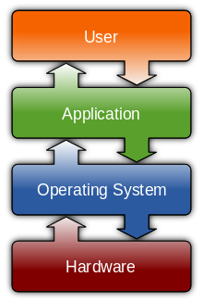
Computer System Components
Notes:
1. Hardware – provides basic computing resources (CPU, memory, I/O devices)
2. Operating system – controls and coordinates the use of the hardware among the various application programs for the various users
3. Applications programs – define the ways in which the system resources are used to solve the computing problems of the users (compilers, database systems, video games, business programs)
4. Users (people, machines, other computers)
Examples of Application:
Compiler
Games
Text editors
Database systems

Slide 9
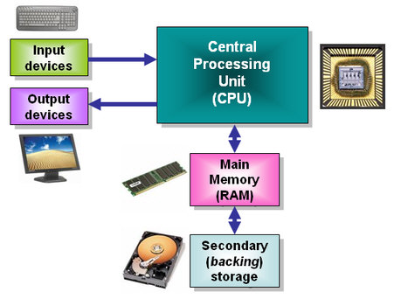
1. Computer Hardware

Slide 10
2. Operating System
It controls and coordinates the use of the HW among the various application programs for the various users
It manages and allocates resources
It controls the execution of user programs and operations of I/O devices
Kernel – the one program running at all times

Slide 11
3. Application Programs
Compilers
Web browsers
Spread sheets
Word processors
…

Slide 12
4. Users
People
Machines
Other Computers

Slide 13
Mainframe Systems

Slide 14
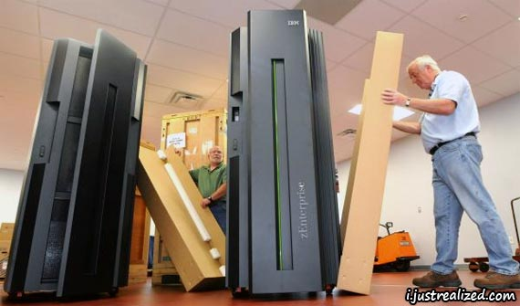
Mainframe Systems
Reduce setup time by batching similar jobs
Automatic job sequencing
Automatically transfers control from one job to another.
First rudimentary operating system

Slide 15
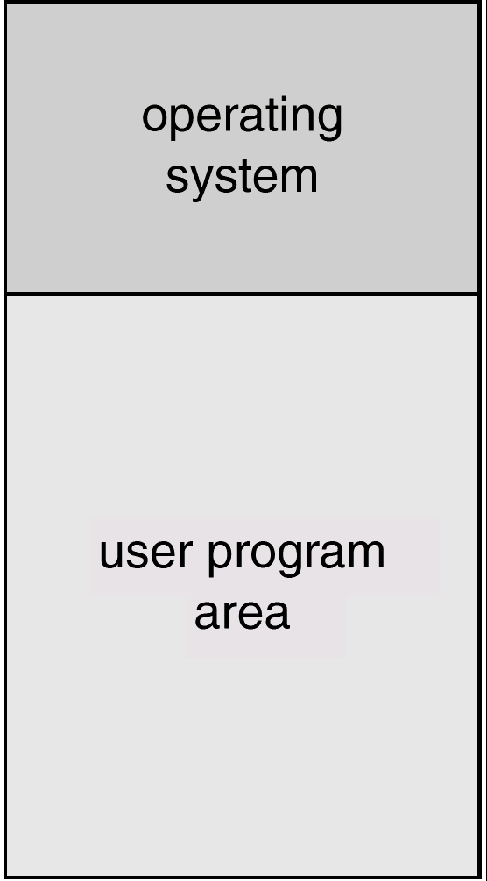
Mainframe Systems Cont’d
Memory Layout for a Simple Batch System

Slide 16
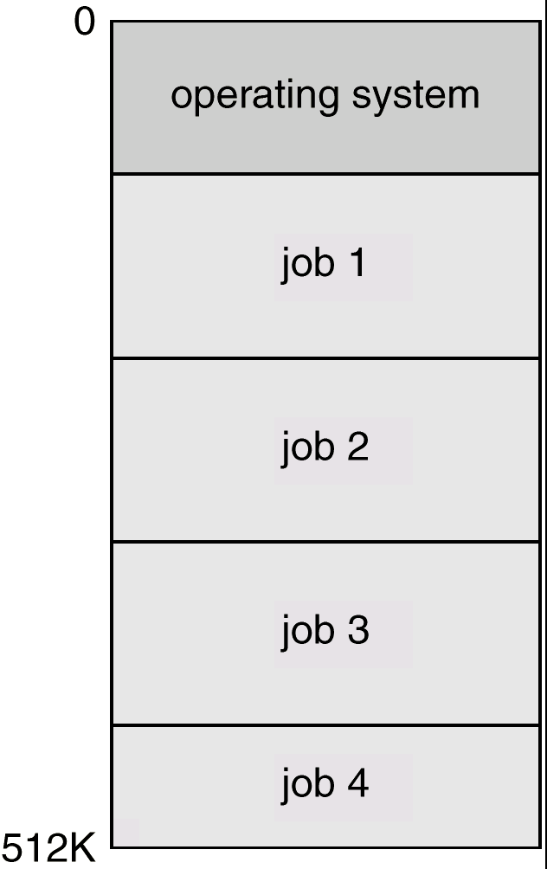
Mainframe Systems Cont’d
Multi-programmed Batch Systems
Several jobs are kept in main memory at the same time, and the CPU is multiplexed among them
OS features needed
I/O routine supplied by the system
Memory management
The system must allocate the memory
to several jobs
CPU scheduling
The system must choose among
several jobs ready to run

Slide 17
Mainframe Systems Cont’d
Time-Sharing Systems (Interactive Computing )
The CPU is multiplexed among several jobs that are kept in memory and on disk
The CPU is allocated to a job only if the job is in memory
A job swapped in and out of memory to the disk
On-line communication between the user and the system is provided
When the operating system finishes the execution of one command, it seeks the next “control statement” from the user’s keyboard

Slide 18
Desktop Systems

Slide 19
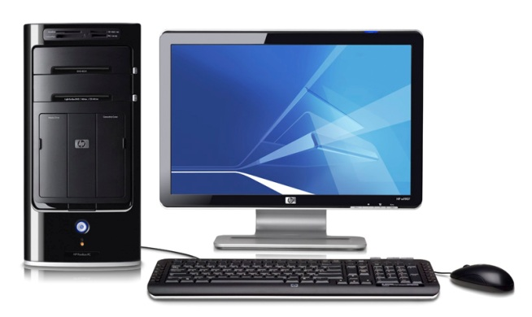
Desktop Systems
Personal computers
Computer system dedicated to a single user
I/O devices
Keyboards
Mice
Display screens
Small printers
User convenience and responsiveness
May run several different types of operating systems (Windows, MacOS, UNIX, Linux)

Slide 20
Multiprocessor Systems

Slide 21
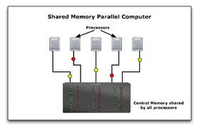
Parallel Systems
Systems with more than one CPU in close communication
Also known as multiprocessor systems
Tightly coupled system
processors share memory and a clock; communication usually takes place through the shared memory
Advantages of parallel system:
Increased throughput
Economical
Increased reliability
graceful degradation

Slide 22
Distributed Systems

Slide 23
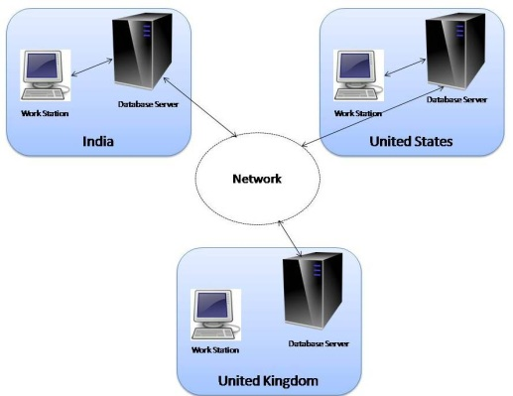
Distributed Systems
Distribute the computation among several physical processors
Loosely coupled system
Each processor has its own local memory
processors communicate with one another through various communications lines, such as high-speed buses or telephone lines
Advantages of distributed systems
Resources Sharing
Computation speed up
Reliability

Slide 24
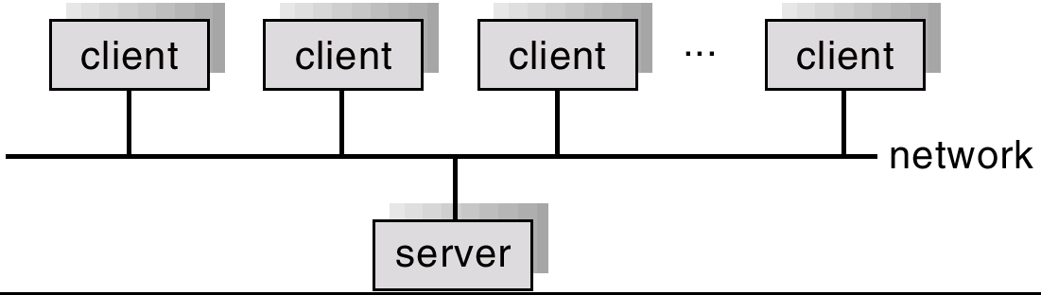
Distributed Systems Cont’d
Requires networking infrastructure
Local area networks (LAN) or Wide area networks (WAN)
May be either client-server or peer-to-peer systems

Slide 25
Clustered Systems

Slide 26
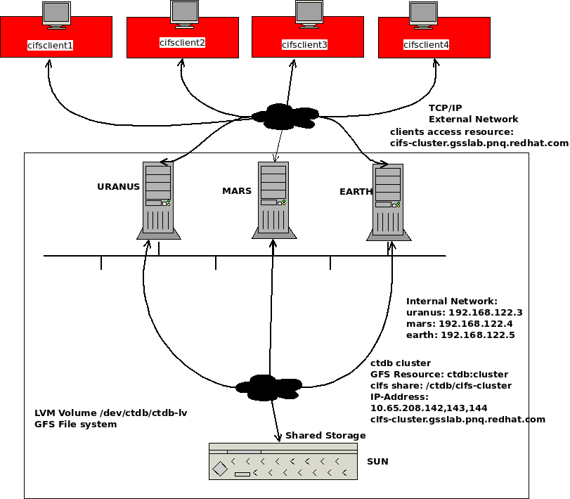
Clustered Systems
Clustering allows two or more systems to share storage
Provides high reliability
Asymmetric clustering: one server runs the application or applications while other servers standby
Symmetric clustering: all N hosts are running the application or applications

Slide 27
Real-Time Systems

Slide 28
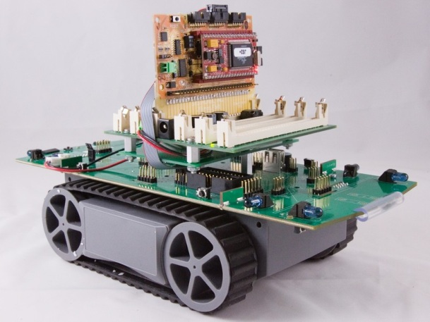
Real-Time Systems
Often used as a control device in a dedicated application such as controlling scientific experiments, medical imaging systems, industrial control systems, and some display systems
Well-defined fixed-time constraints
Real-Time systems may be either hard or soft real-time

Slide 29
Real-Time Systems Cont’d
Hard real-time:
Secondary storage limited or absent, data stored in short term memory, or read-only memory (ROM)
Conflicts with time-sharing systems, not supported by general-purpose operating systems
Soft real-time
Limited utility in industrial control of robotics
Integrate-able with time-share systems
Useful in applications (multimedia, virtual reality) requiring tight response times

Slide 30
Handheld Systems

Slide 31
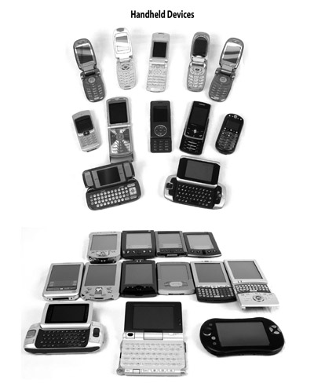
Handheld Systems
Personal Digital Assistants (PDAs)
Cellular telephones
Issues:
Limited memory
Slow processors
Small display screens

Slide 32
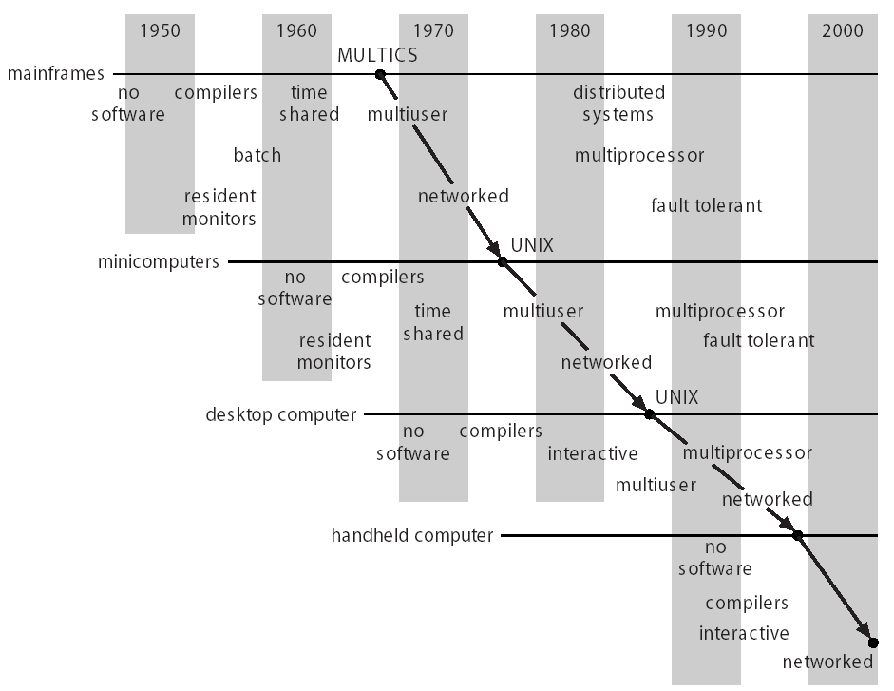
Migration of Operating-System Concepts and Features

Slide 33
Computing Environments
Traditional computing
PCs, Servers, limited remote access
Web-Based Computing
Client-server and web services, convenient remote access, location-less servers
Embedded Computing
Most computers (auto engine controllers, microwaves)
Very limited operating system features
Little or no user interface, remote access

